Slide 1


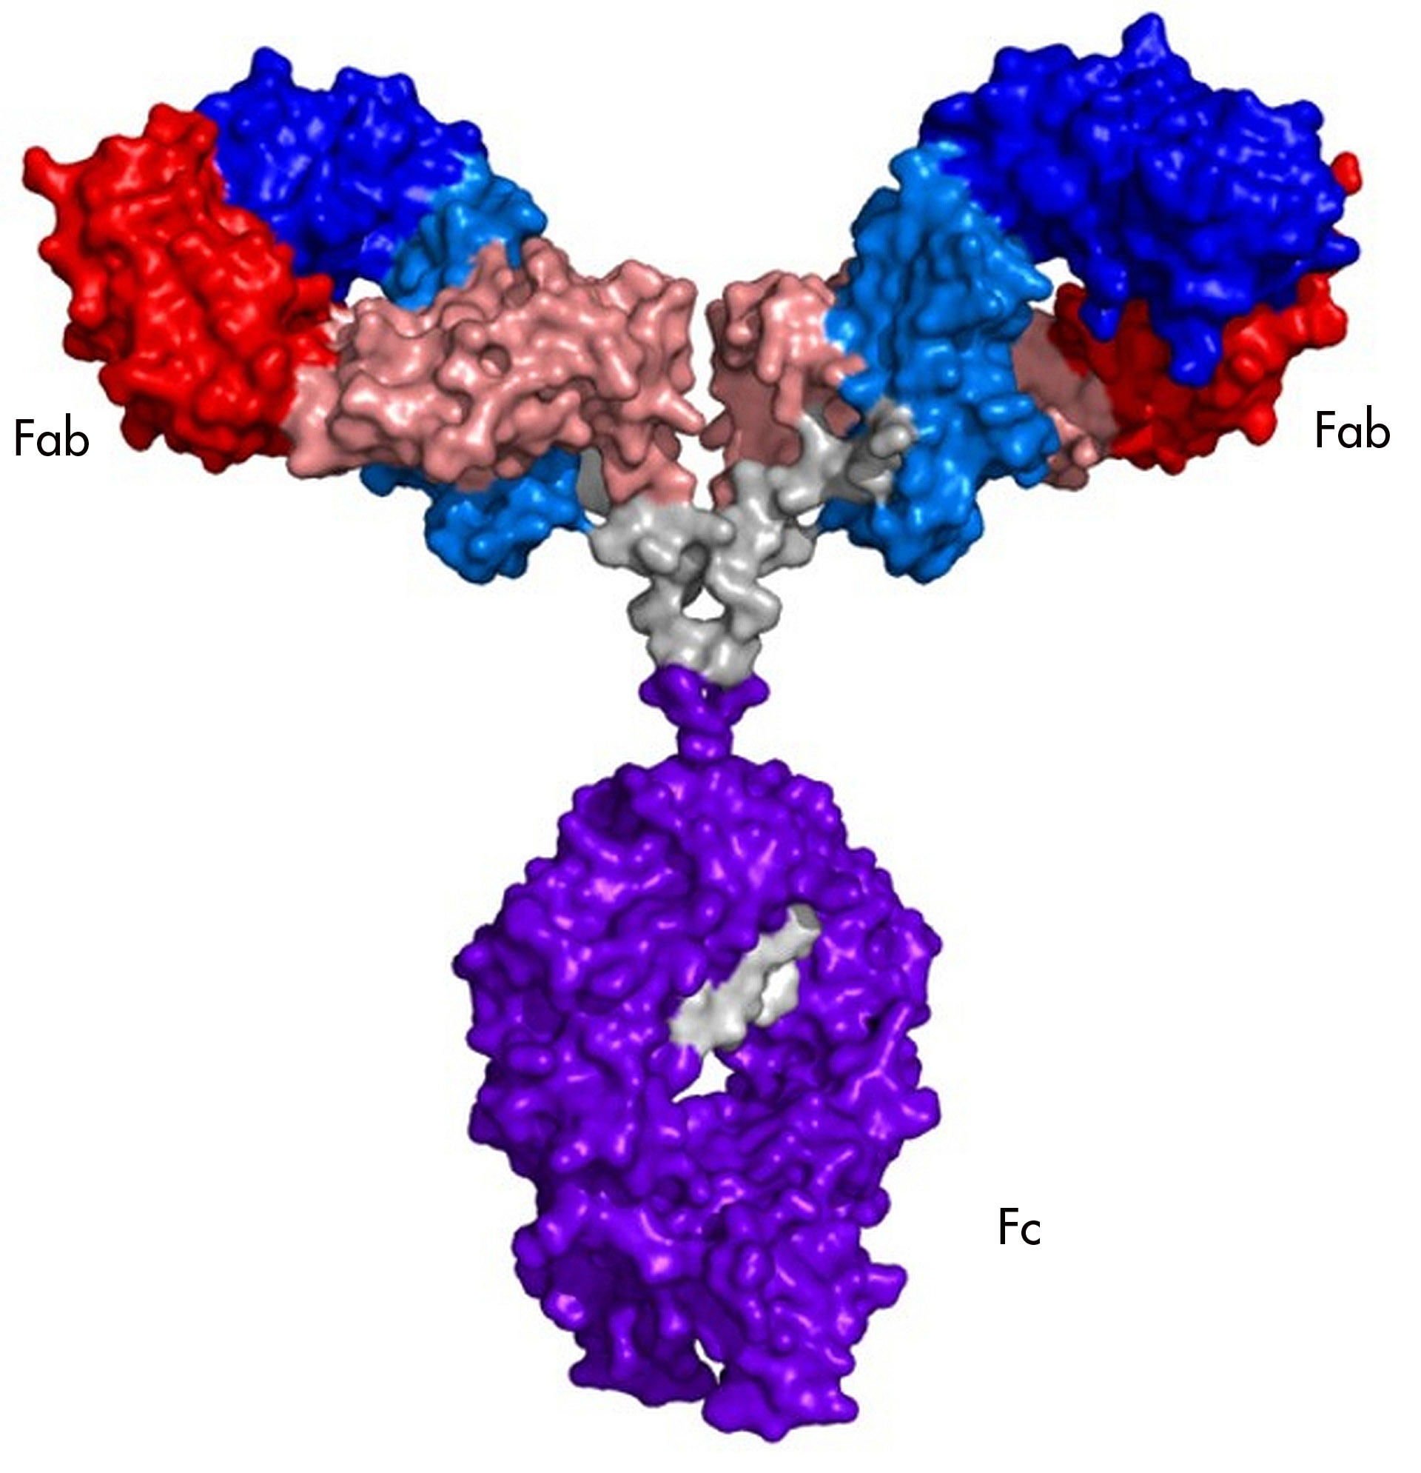
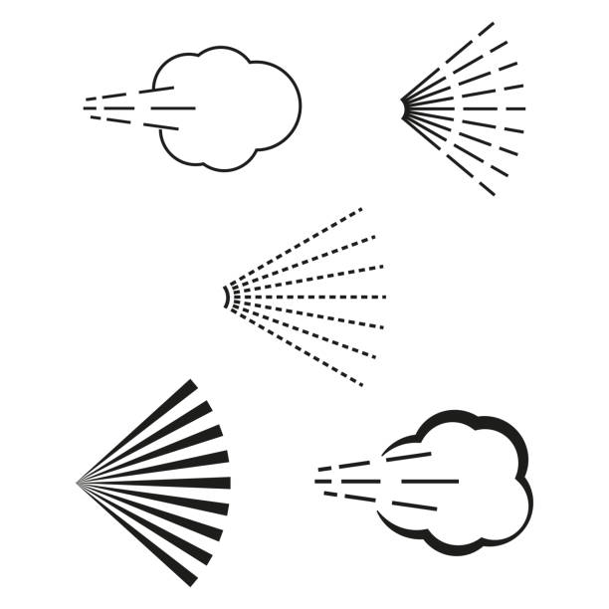
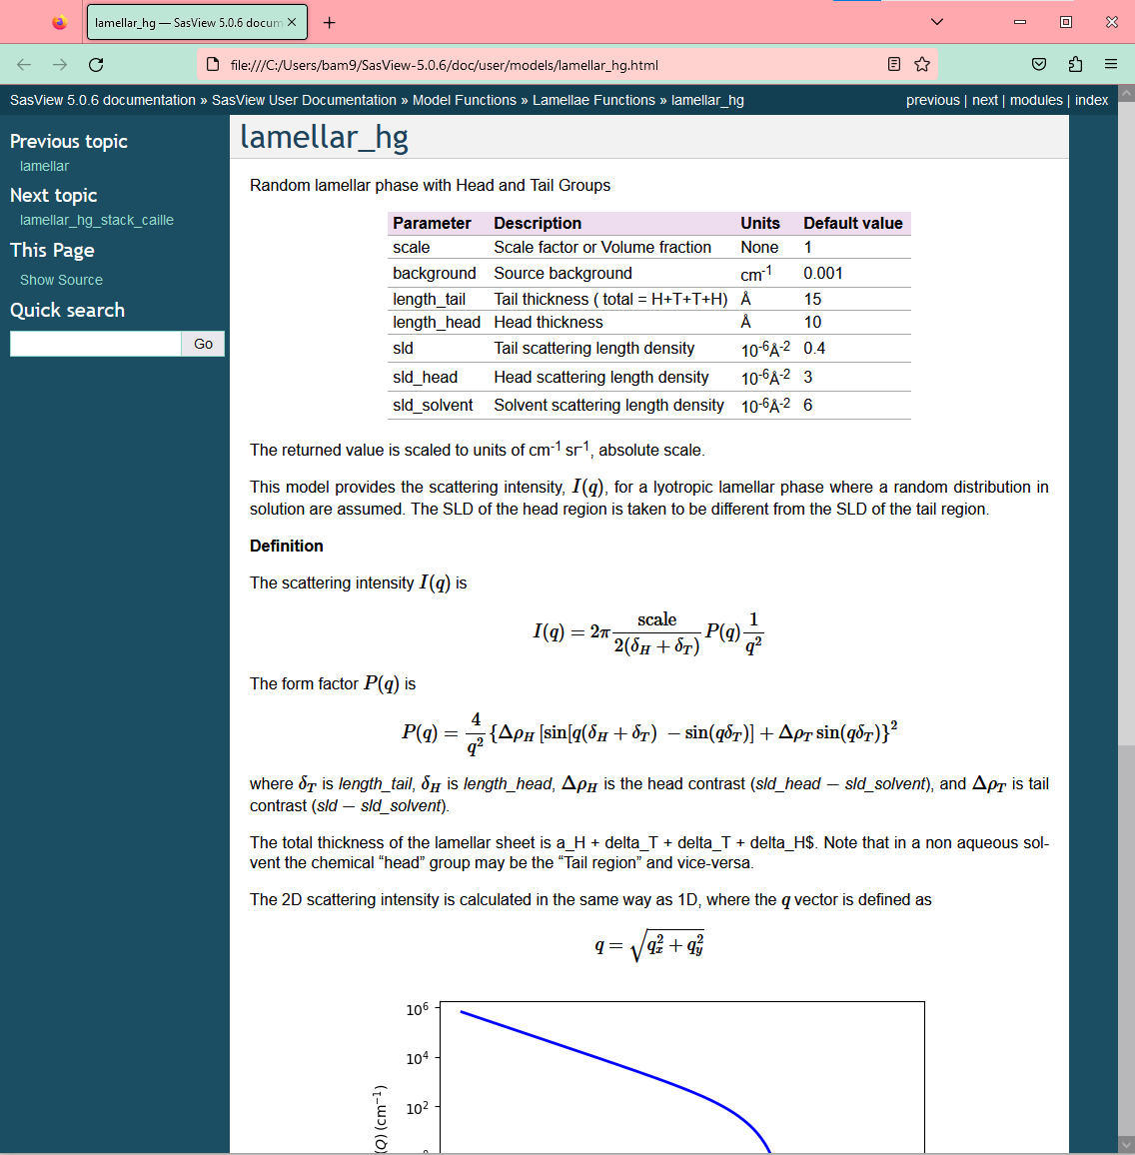
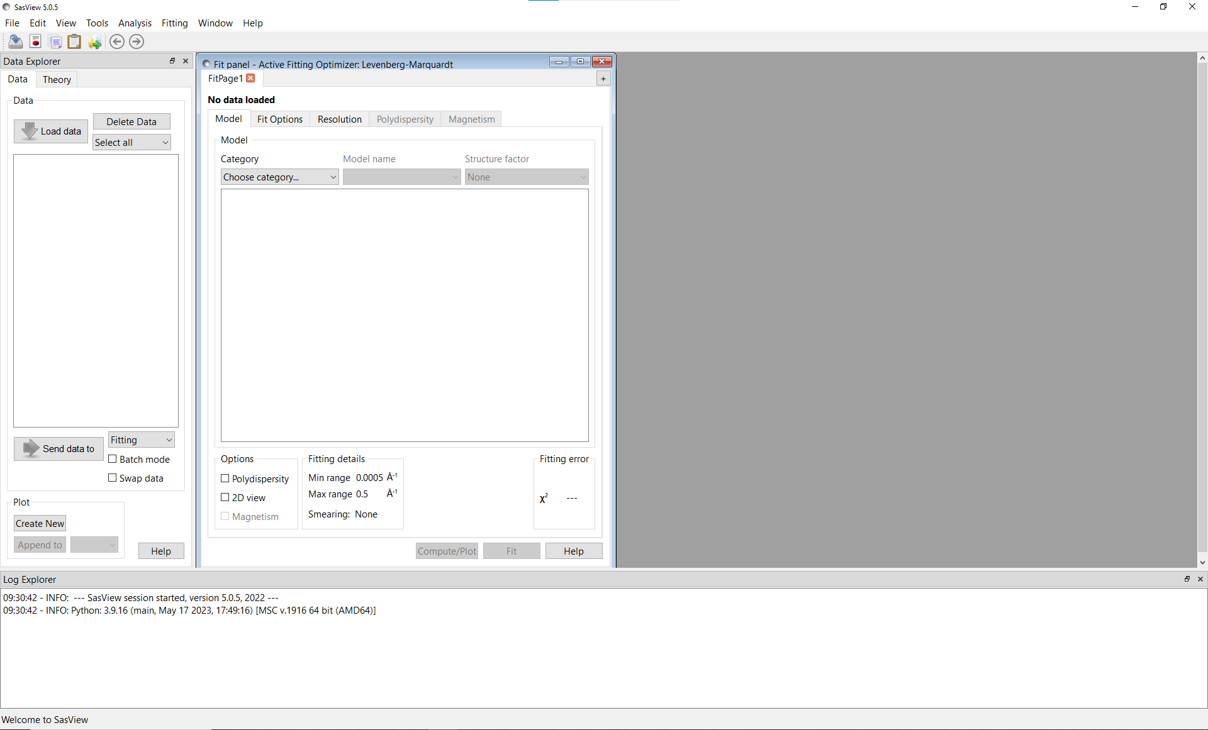

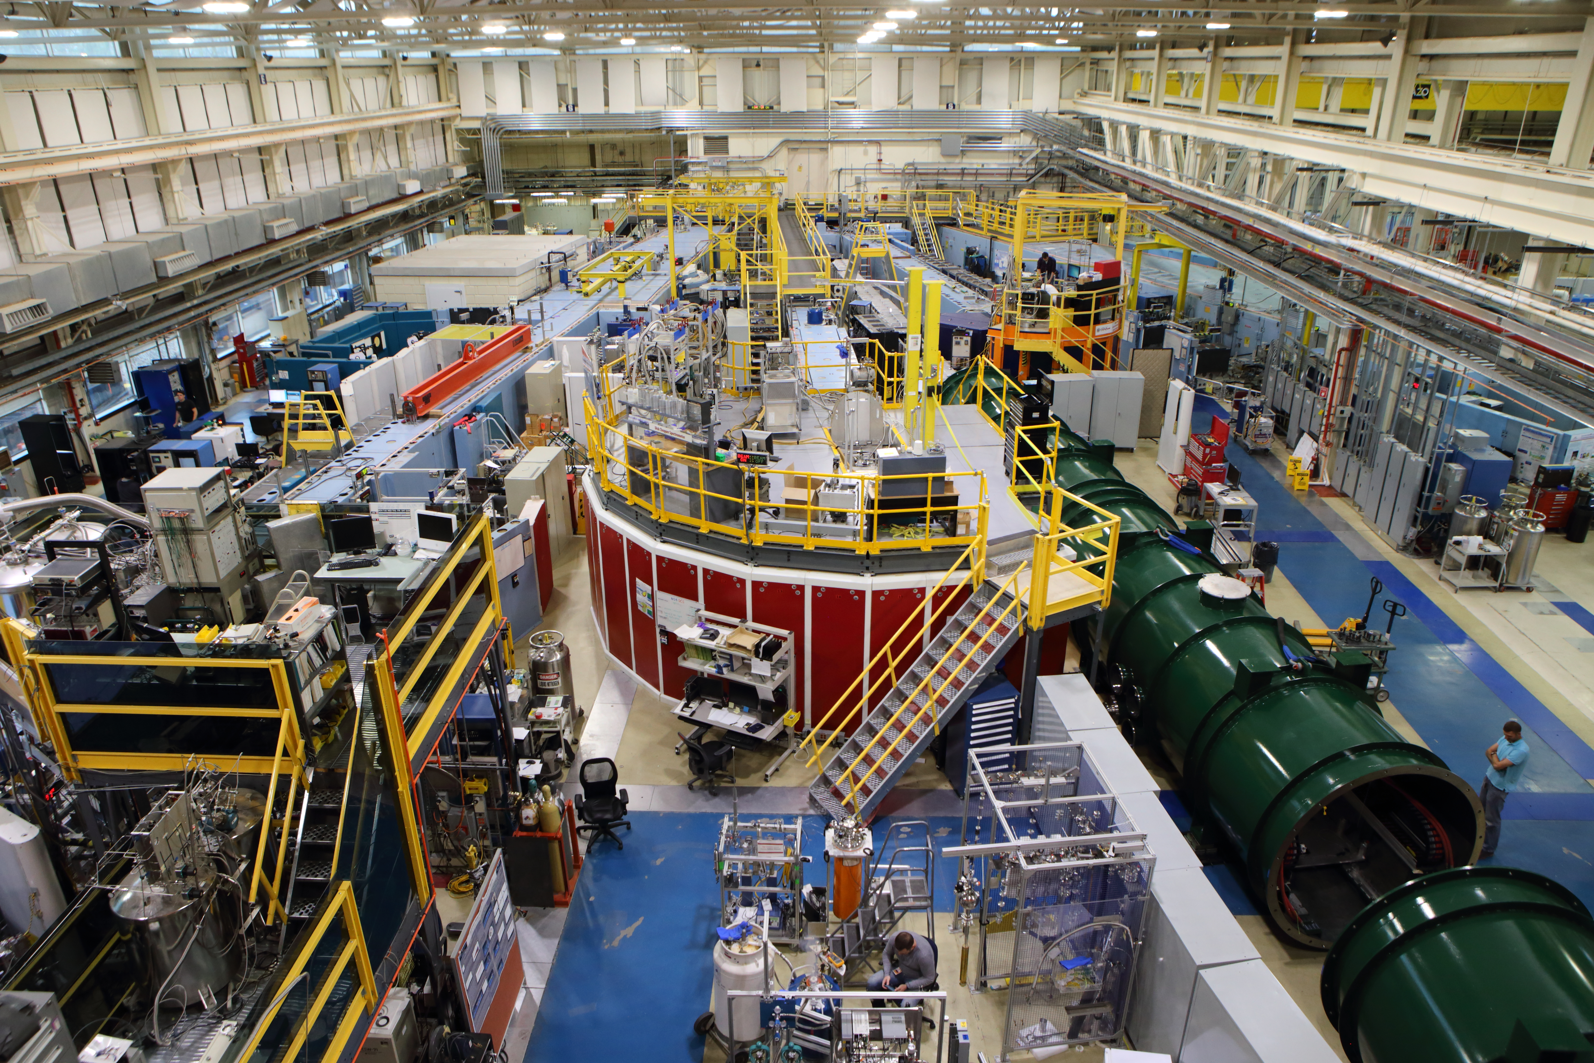
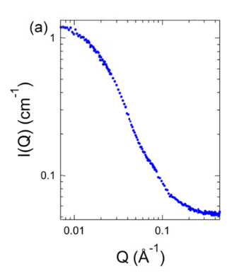
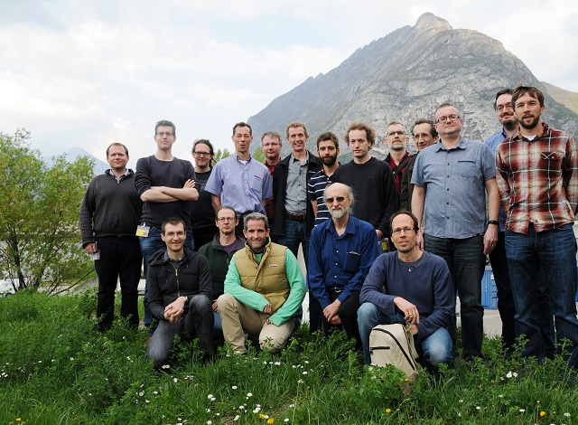
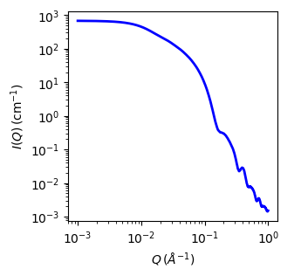
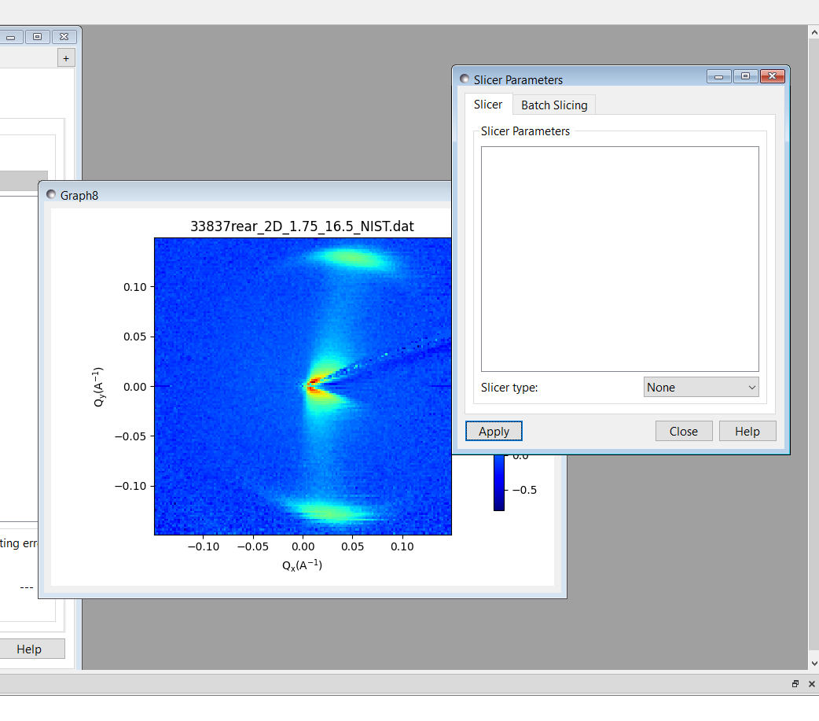
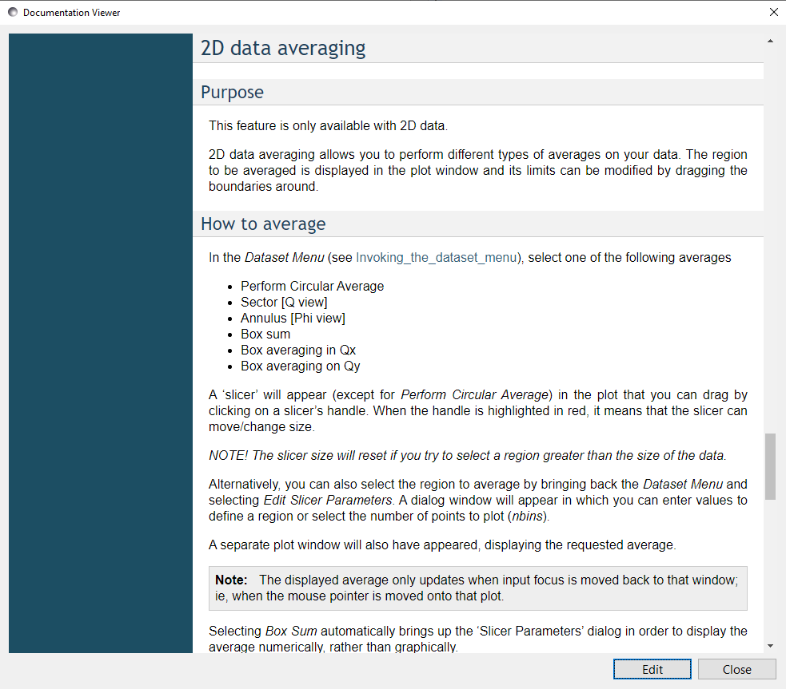
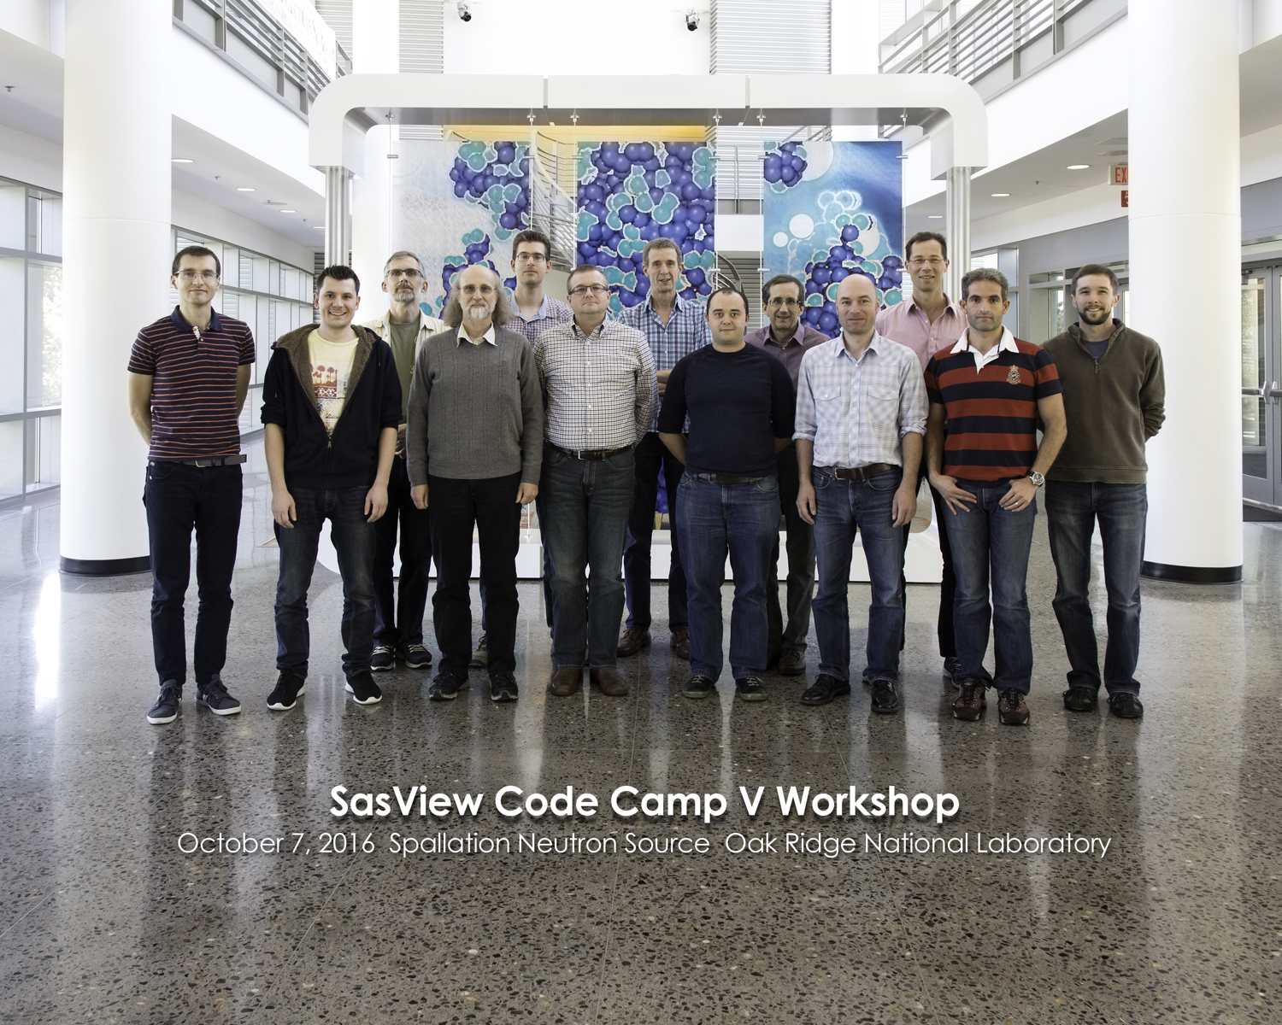
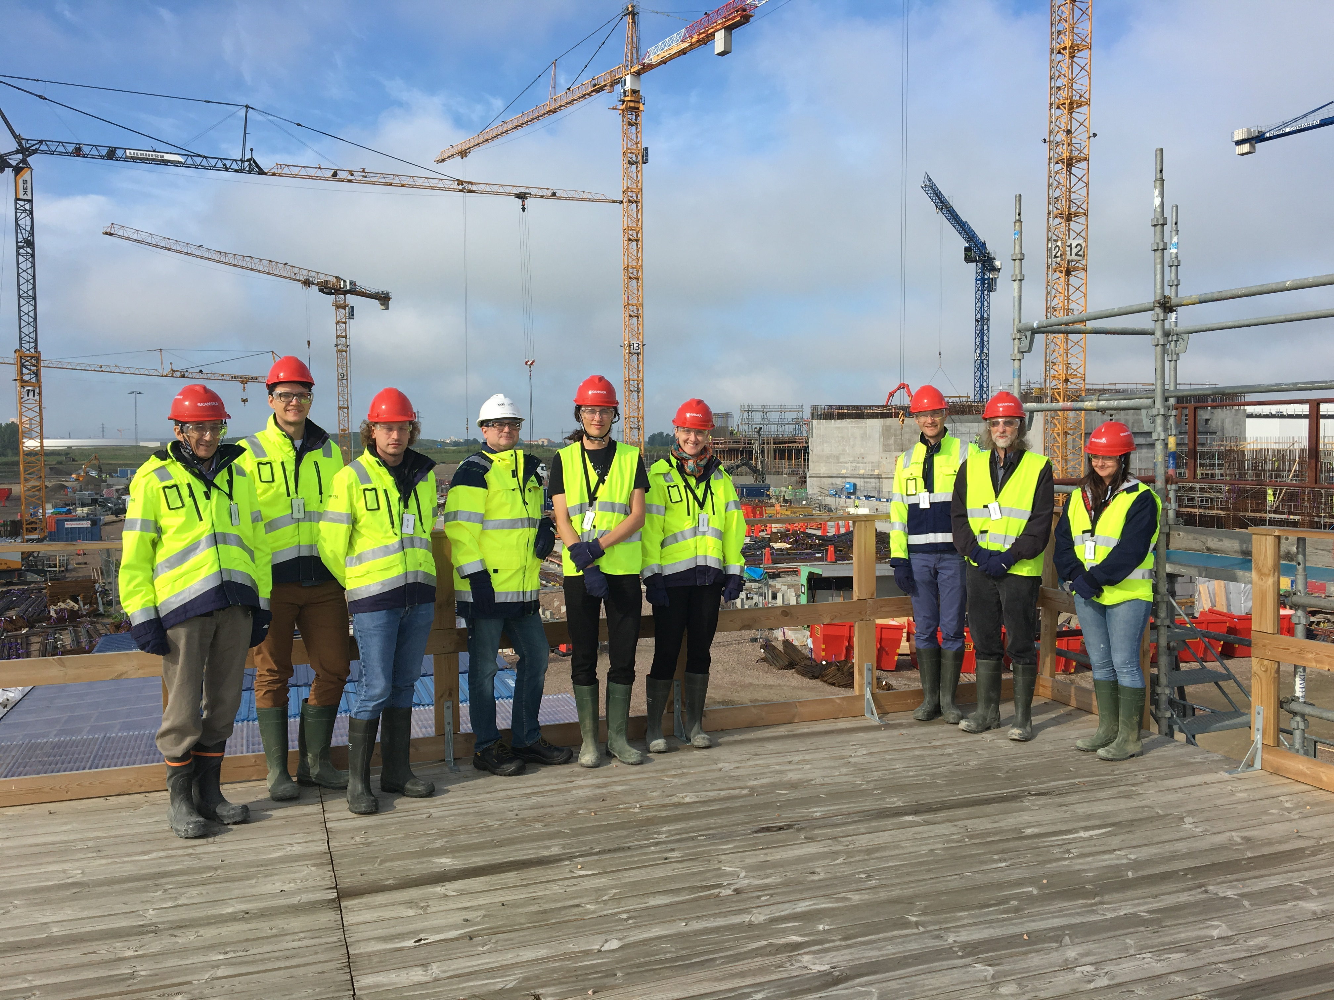
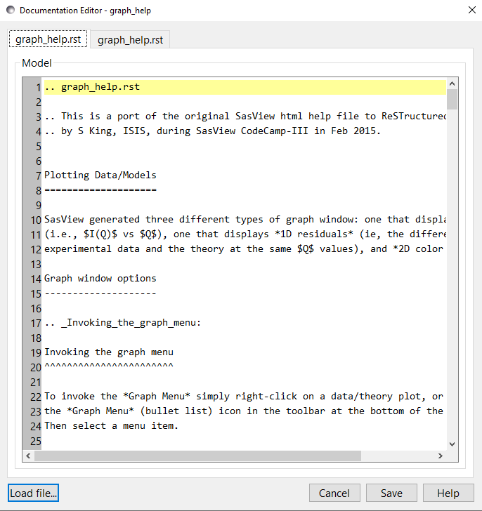
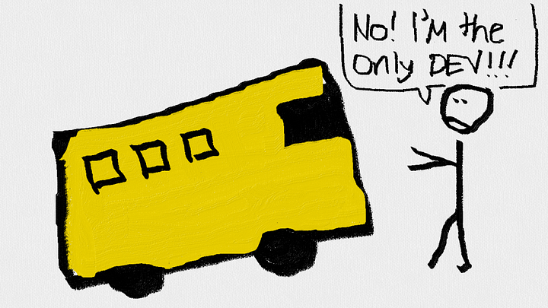


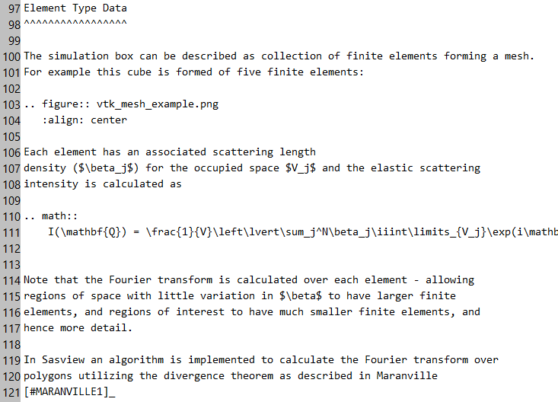
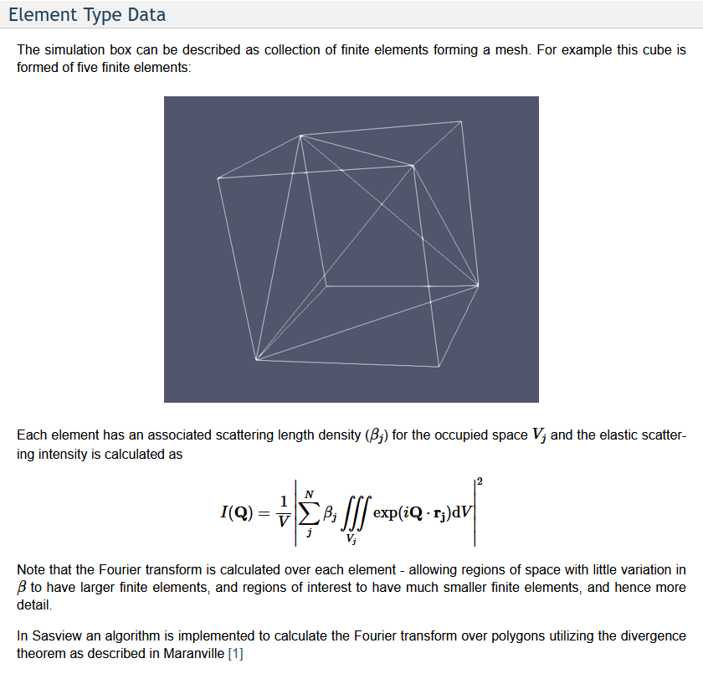













Dynamic Documentation Generation and Crowdsourcing in SasView
Brayden Miller
Dr. Paul Butler, Mentor
Albert Einstein High School
Background
Before
The Documentation Problem (cont’d)
Web Browser
SasView
Small angle scattering (SAS): What is it?
Sample Molecule
Detector
SasView has three types of documentation, each with its own problems:
Scientists ask a question:
WHAT ARE CHARACTARISITICS OF THIS MOLECULE?
Source
NEUTRONS
?
Model
Documentation
Developer
SAS is used to determine these characteristics, giving us data that must be analyzed. This can be done manually but is greatly enhanced using analysis software.
What we write ✔️
What we see ❌
❌
OPENS
ANALYSIS
User
Outside scope of project
MODEL DOCUMENTATION
What we write❌
What we see ✔️
The NIST Center for Neutron Research (NCNR) works to supply both the equipment (shown left) and the analysis software necessary for modern SAS techniques.
Fitting is a core analysis in SasView. If users know the general shape of their molecule, they can write an equation, called a model, to represent its shape. Variables in this model represent unknown parameters, like radius and length below.
“NIST 2D NMR ‘fingerprinting’ Study Gives Biopharmaceutical Sector New Power to Assure High Quality Monoclonal Antibody Therapeutics.” NIST, December 21, 2018. https://www.nist.gov/news-events/news/2018/12/nist-2d-nmr-fingerprinting-study-gives-biopharmaceutical-sector-new-power.
USER DOCUMENTATION
After Project
SasView
Data
User documentation assists users with the functionality of SasView and some of the theory involved in its calculations.
“NCNR East Guide Hall.” NIST, April 17, 2017. https://www.nist.gov/image/20170417016guidehalljpg.
DOCUMENTATION MUST BE CONSTANTLY EVOLVING
SasView
Documentation Viewer inside SasView
SasView is a SAS software analysis suite.
Capable of a wide variety of analysis operations
Extensive documentation ~140 Pages, some ~6,000 words
Maintained by community
t₁
SASVIEW IS COLLABORATIVE
t₂
I = f(t₁ t₂)
We need to have an easy solution for letting the community edit documentation!
OPENS
SasView is an open-source, collaborative, and international project
Researchers frequently write their own models and share them with the community. Writing documentation is possible, but it is not visible to users when ‘Help’ is pressed for their models.
Open source – READABLE AND CONTRIBUTABLE BY ALL
Collaborative – PROTECTED FROM THE “BUS FACTOR”
Users may see errors in documentation or be knowledgeable in an area of documentation and want to contribute. The current process involves:
Using a GitHub account
Cloning a repository
Installing dependencies
Running setup and config files via command line
Edit raw RST documentation files by navigating source tree
Running Makefile via command line to view HTML version
Help Button Pressed
This means SasView is developed sustainably, with the goal that it can continue to be developed in the future. Unlike many alternative tools for SAS analysis, it has a consistent release cycle.
If a bus were to hit members of the developer team (or if they were to retire), the project will live on!
REFRESHES
OPENS
Edit Button Pressed
Functionality Included
Ahmed, Adnan. “The Bus Factor.” Tajawal (blog), May 4, 2018. https://medium.com/tech-tajawal/the-bus-factor-6ea1a3ede6bd.
THIS IS TOO DIFFICULT OR TIME CONSUMING FOR A LARGE SET OF USERS!
ci.yml (Github Actions)
Formerly on
Objective:
Makefile
gentoc.py
genmodel.py
The Documentation Problem
WHAT DOES DOCUMENTATION LOOK LIKE?
Make changes to
ReST documentation
in SasView GUI editor
Sphinx
(via command line)
HTML Files
..\_build\html
RST Files
..\model\*.rst
Design Considerations:
Save Button Pressed
Compiling +
Formatting
Purpose is to lower barrier to entry
View changes
in HTML
formatted docs
Summary
Functional
Easy to use
Minimal changes to code structure
Bonus:
Math will display regardless of browser settings
Future work:
Automatic submission of edits to documentation
Documentation regeneration scripts can be optimized
Math still needs internet connection to display correctly
Accomplishments:
Allow users to edit documentation locally
Create opportunities for crowdsourcing SasView
Documentation for community models is now visible
What we write
(not user-friendly)
What we see
(user-friendly)
Submit corrected
ReST files
to developers
Files are written in a mix of Restructured Text (ReST) and LaTeX for embedded mathematics. The viewable files are structured using HTML.
SasView is a large codebase, we need to develop sustainably

